Slide 1
Mobile layout
I’m using the model of fakespot.com, a competitive website as an example as it shows very similar info. Please make mobile version follow the designs on the desktop version.

Slide 2
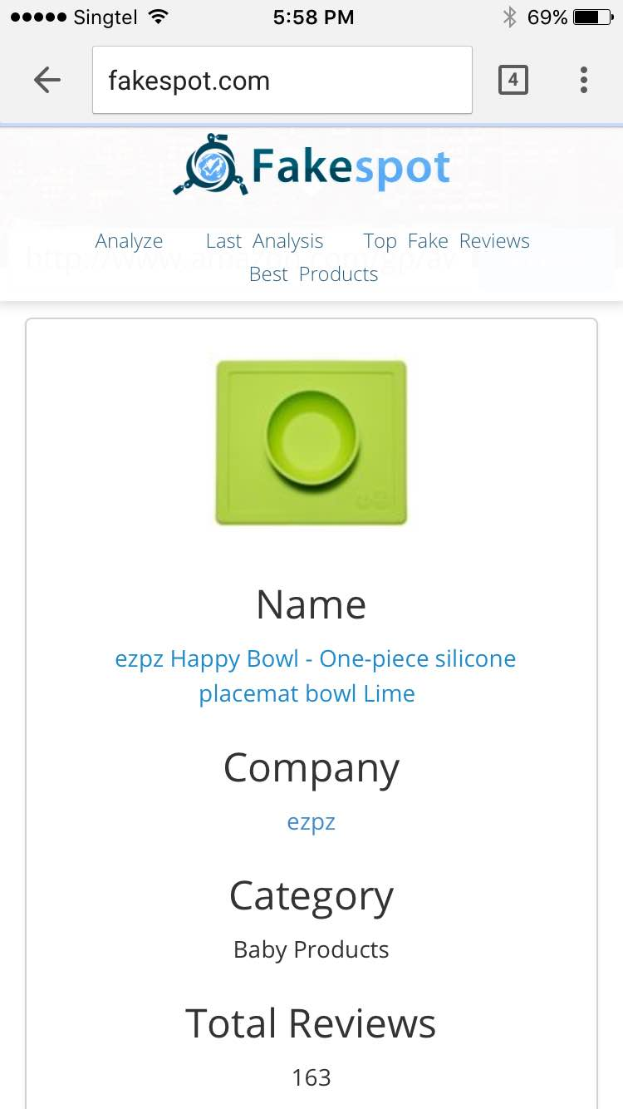

The top banner needs to be thinner than the one
On fakespot.com with a similar to desktop site:
This top area should be a similar layout to
fakespot.com. Image on top, followed by Name,
Company, Category, Total Reviews,

Slide 3
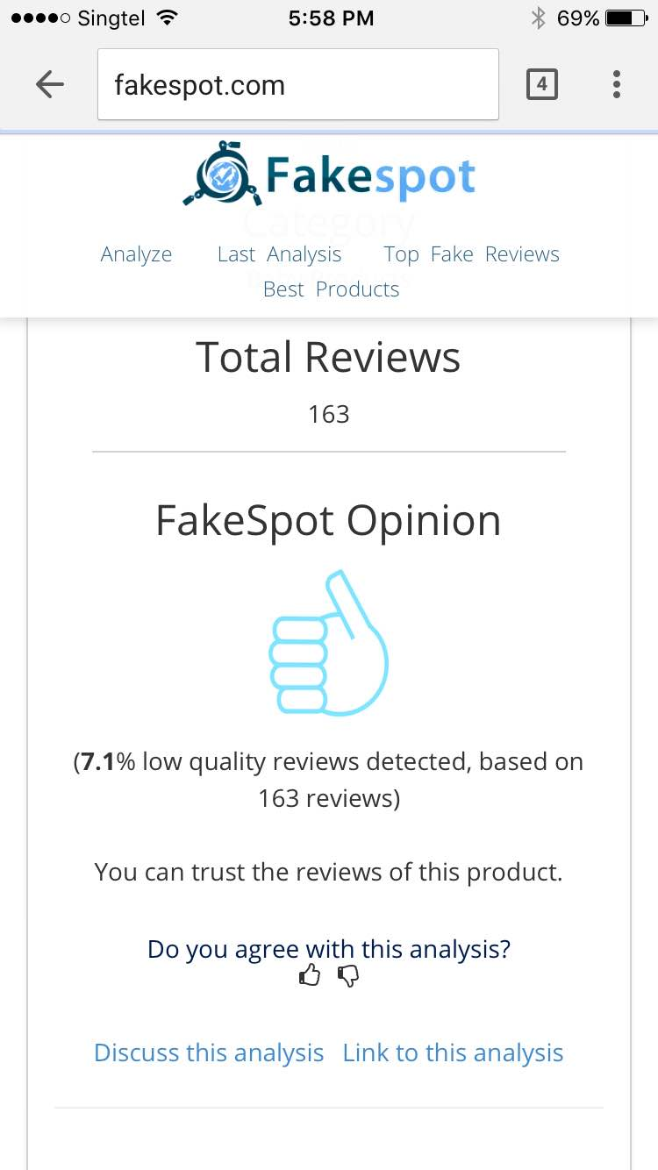



The next sections should be in this order:
Reveal Review Score
Fake Reviews % and Thumb icon (see left side)
We Recommend section

Slide 4
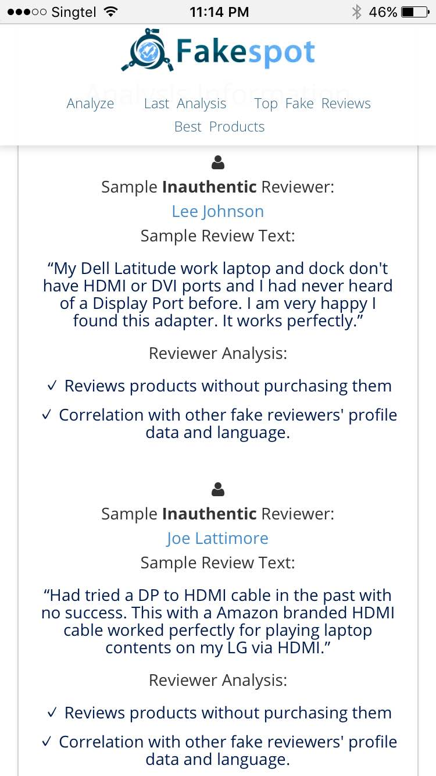
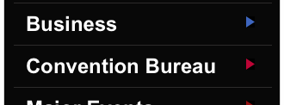

Next will come the ‘Untrustworthy Reviews’ section. These need to be hidden behind an optional
Dropdown section, similar to this, but using black
Letters and white background, exactly as the desktop
Design:
Unlike the desktop version, once expanded in the mobile version, the example reviews will need to show all the data together as here on the left, instead of using the ‘WHY?’ hover-over icon. Similar to the fakespot example on the left here.

Slide 5


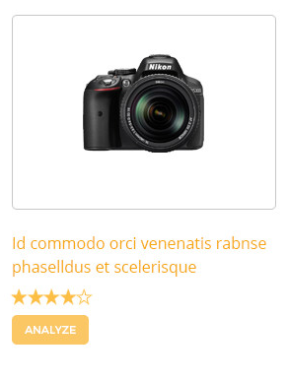
Last section will show ‘Related Products’ which will also be an optional choice with a dropdown as in the example on Slide 4.
Instead of showing 4 products however, the mobile version should only show 1 and allow the users to scroll left and right to see more related products.

